Slide 1
Nature vs. Nurture

Slide 2
Nature and Nurture
When both DNA(Nature) and life experience/exposure(nurture) contribute to a phenotype
TRAIT | NATURE | NURTURE
Skin color | Inherited genes for skin color | Sun can darken or redden skin or cause freckles to appear
Height
BUZZER: Traits influence by both DNA and environment tend to have a wide range of phenotypes

Slide 3
How would it be possible to determine how much of a phenotype was controlled by nature and how much by nurture?
Twins: Is it All in the Genes?
BUZZER: Identical twins develop from one single fertilized egg so they have the same genome.
Differences can be due to their environment and not genes.
Jim Twins
Notes:
https://www.youtube.com/watch?v=Wd5Y3-F79LY
Jim twins: https://www.youtube.com/watch?v=qw3S35wGgT8

Slide 4
What's your risk activity

Slide 5
EPIGENETICS
Epi = above = chemical modifications to the DNA or the histones that don't change the DNA sequence
Epigenetic changes turn genes on/off
Epigenetic changes are copied with the DNA during cell division
GENOME | EPIGENOME
DNA SEQUENCES | Directions to turn a gene on/off

Slide 6
Epigenetic Mechanisms
DNA methylation
  Usually turns genes off
  CH₃ group added to some cytosine nucleotides
2. Histone modification (ex. Acetylation)
Turns genes off by causing DNA to wrap more tightly around histone so RNA polymerase cannot get to the gene DNA sequence

Slide 7
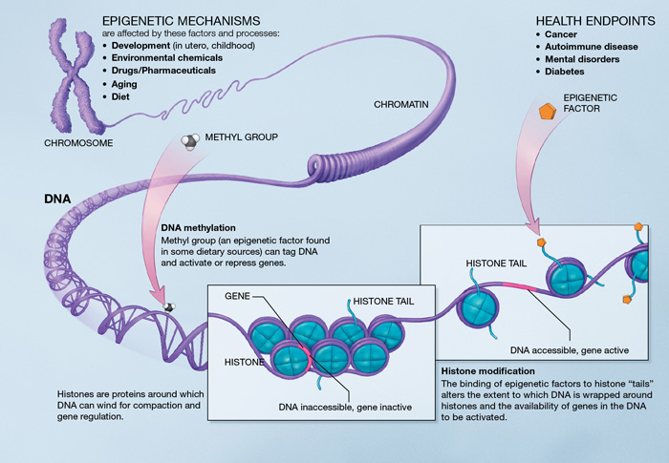
http://www.google.com/imgres?imgurl=http://upload.wikimedia.org/wikipedia/commons/d/dd/Epigenetic_mechanisms.jpg&imgrefurl=http://en.wikipedia.org/wiki/Epigenetics&h=485&w=700&tbnid=6k1j0IBptYW9cM:&zoom=1&docid=o0OZS0cnsofOqM&hl=en&ei=eH0iVbqbMOq1sAS5y4KABA&tbm=isch&ved=0CB0QMygAMAA

Slide 8
REPROGRAMMING
In most cases, gametes are wiped clean of epigenetic markers acquired during that parents life - this process is called reprogramming.

Slide 9
Epigenetic Videos
Epigenome at a Glance
Epigenetics of Identical Twins
Lick your rat
Epigenetics: Spanish Twins
http://www.pbs.org/wgbh/nova/body/epigenetic-mice.html
Notes:
http://learn.genetics.utah.edu/content/epigenetics/intro/
http://learn.genetics.utah.edu/content/epigenetics/twins/
http://learn.genetics.utah.edu/content/epigenetics/rats/
http://www.pbs.org/wgbh/nova/body/epigenetics.html

