Slide 1
Analysis of Research Impact
and Implications for Funding Policy
AAI
May 14, 2016

Slide 2
FY16 Payline Update
Requested Direct Costs | <500k |  | 500k or greater
Allocation | General |  | General
All applications except N.I. or E.S.I. R01s | 9% |  | 6%
N.I. R01s | 17% |  | 14%
E.S.I. R01s | 19% |  | 16%

Slide 3
FY16 Budget Status –
Funding Increases Across the Board
$32 Billion for the NIH
$200M for PMI
$85M for BRAIN
$350M for AD
$1.6B for the NIA
∼4 percent increases across all ICs (not counting the $$ above) – 4.2% for the NIA
All divisions will benefit
  DBSR
  DGCG
  DAB
  DN

Slide 4
NIA Appropriations FY 2005-2017 PB
Current versus Constant, FY05 Base Year
Difference from FY2006
In Current Dollars: $561.6M Increase
In Constant Dollars: $62.7M Increase
6.3% increase
FY06-FY17

Slide 6
FY16 Payline Update
Requested Direct Costs | <500k |  | 500k or greater
Allocation | General | AD research | General | AD research
All applications except N.I. or E.S.I. R01s | 9% | 22% | 6% | 19%
N.I. R01s | 17% | 25% | 14% | 22%
E.S.I. R01s | 19% | 27% | 16% | 24%

Slide 7
Update of Bibliometric Analyses of NIA Papers, Grants, and Scientists
Michael S Lauer, MD
Deputy Director for Extramural Research
National Institutes of Health

Slide 8

So How Do We Measure Research Impact?
P = productivity
  Publish trial results
  Highly-cited papers
Q = quality
R = replication
S = sharing
T = translation
Ioannidis JP, Khoury MJ. JAMA 2014 (June 9)

Slide 9
Let’s Take a First Look
5664 NIA RPG Grants 1985 – 2011
Yielded 55,504 unique publications
Of these 15,612 were “top 10%”
Proportion “top 10%” is 28%
Portfolio performs 3X better than expected
Many thanks to Dr. Rasheda Parks and Dr. Samir Sauma

Slide 10
Three Perspectives
Paper-based
Grant-based
Scientist-based

Slide 11
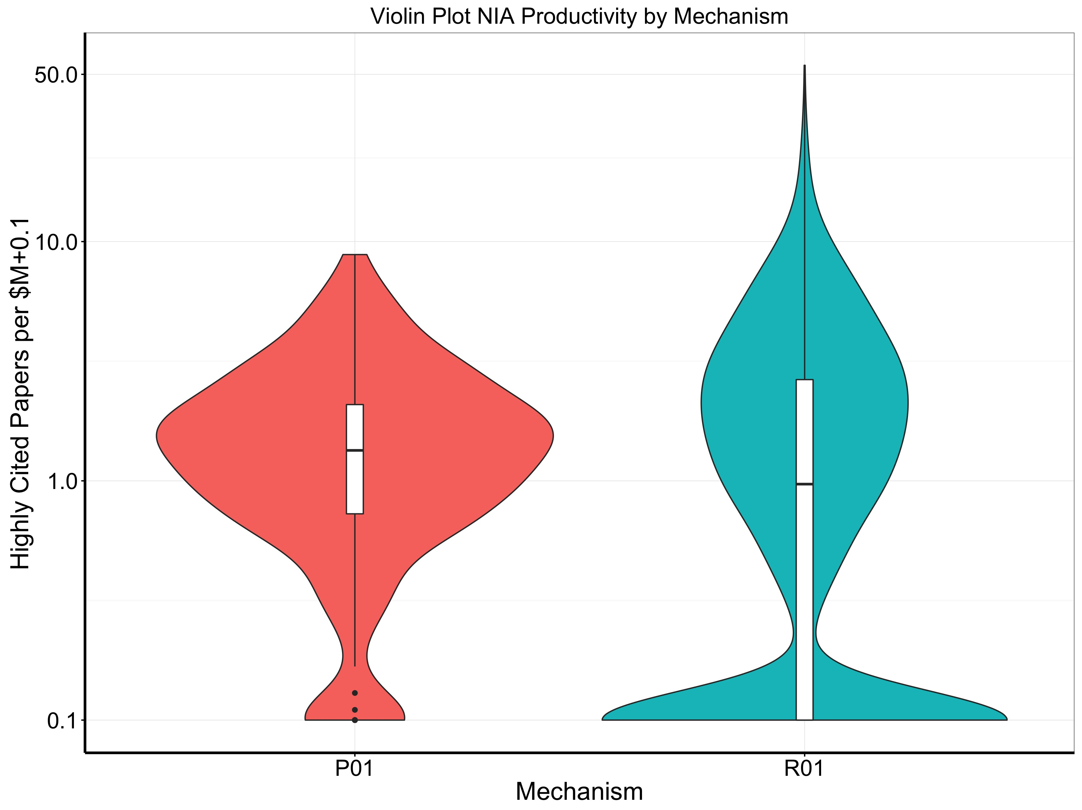

Slide 12
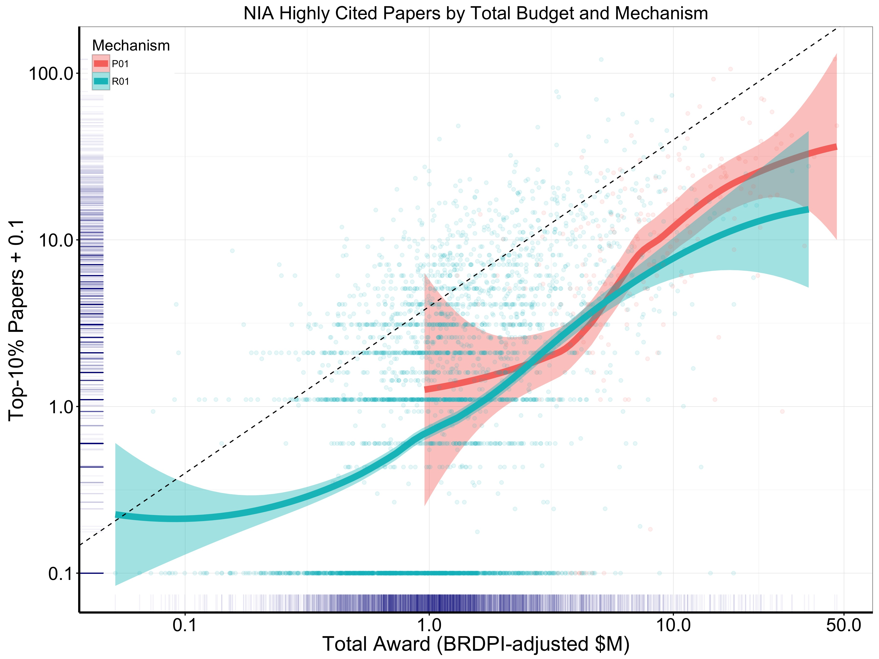

Slide 13
Three Perspectives
Paper-based
Grant-based
Scientist-based

Slide 14
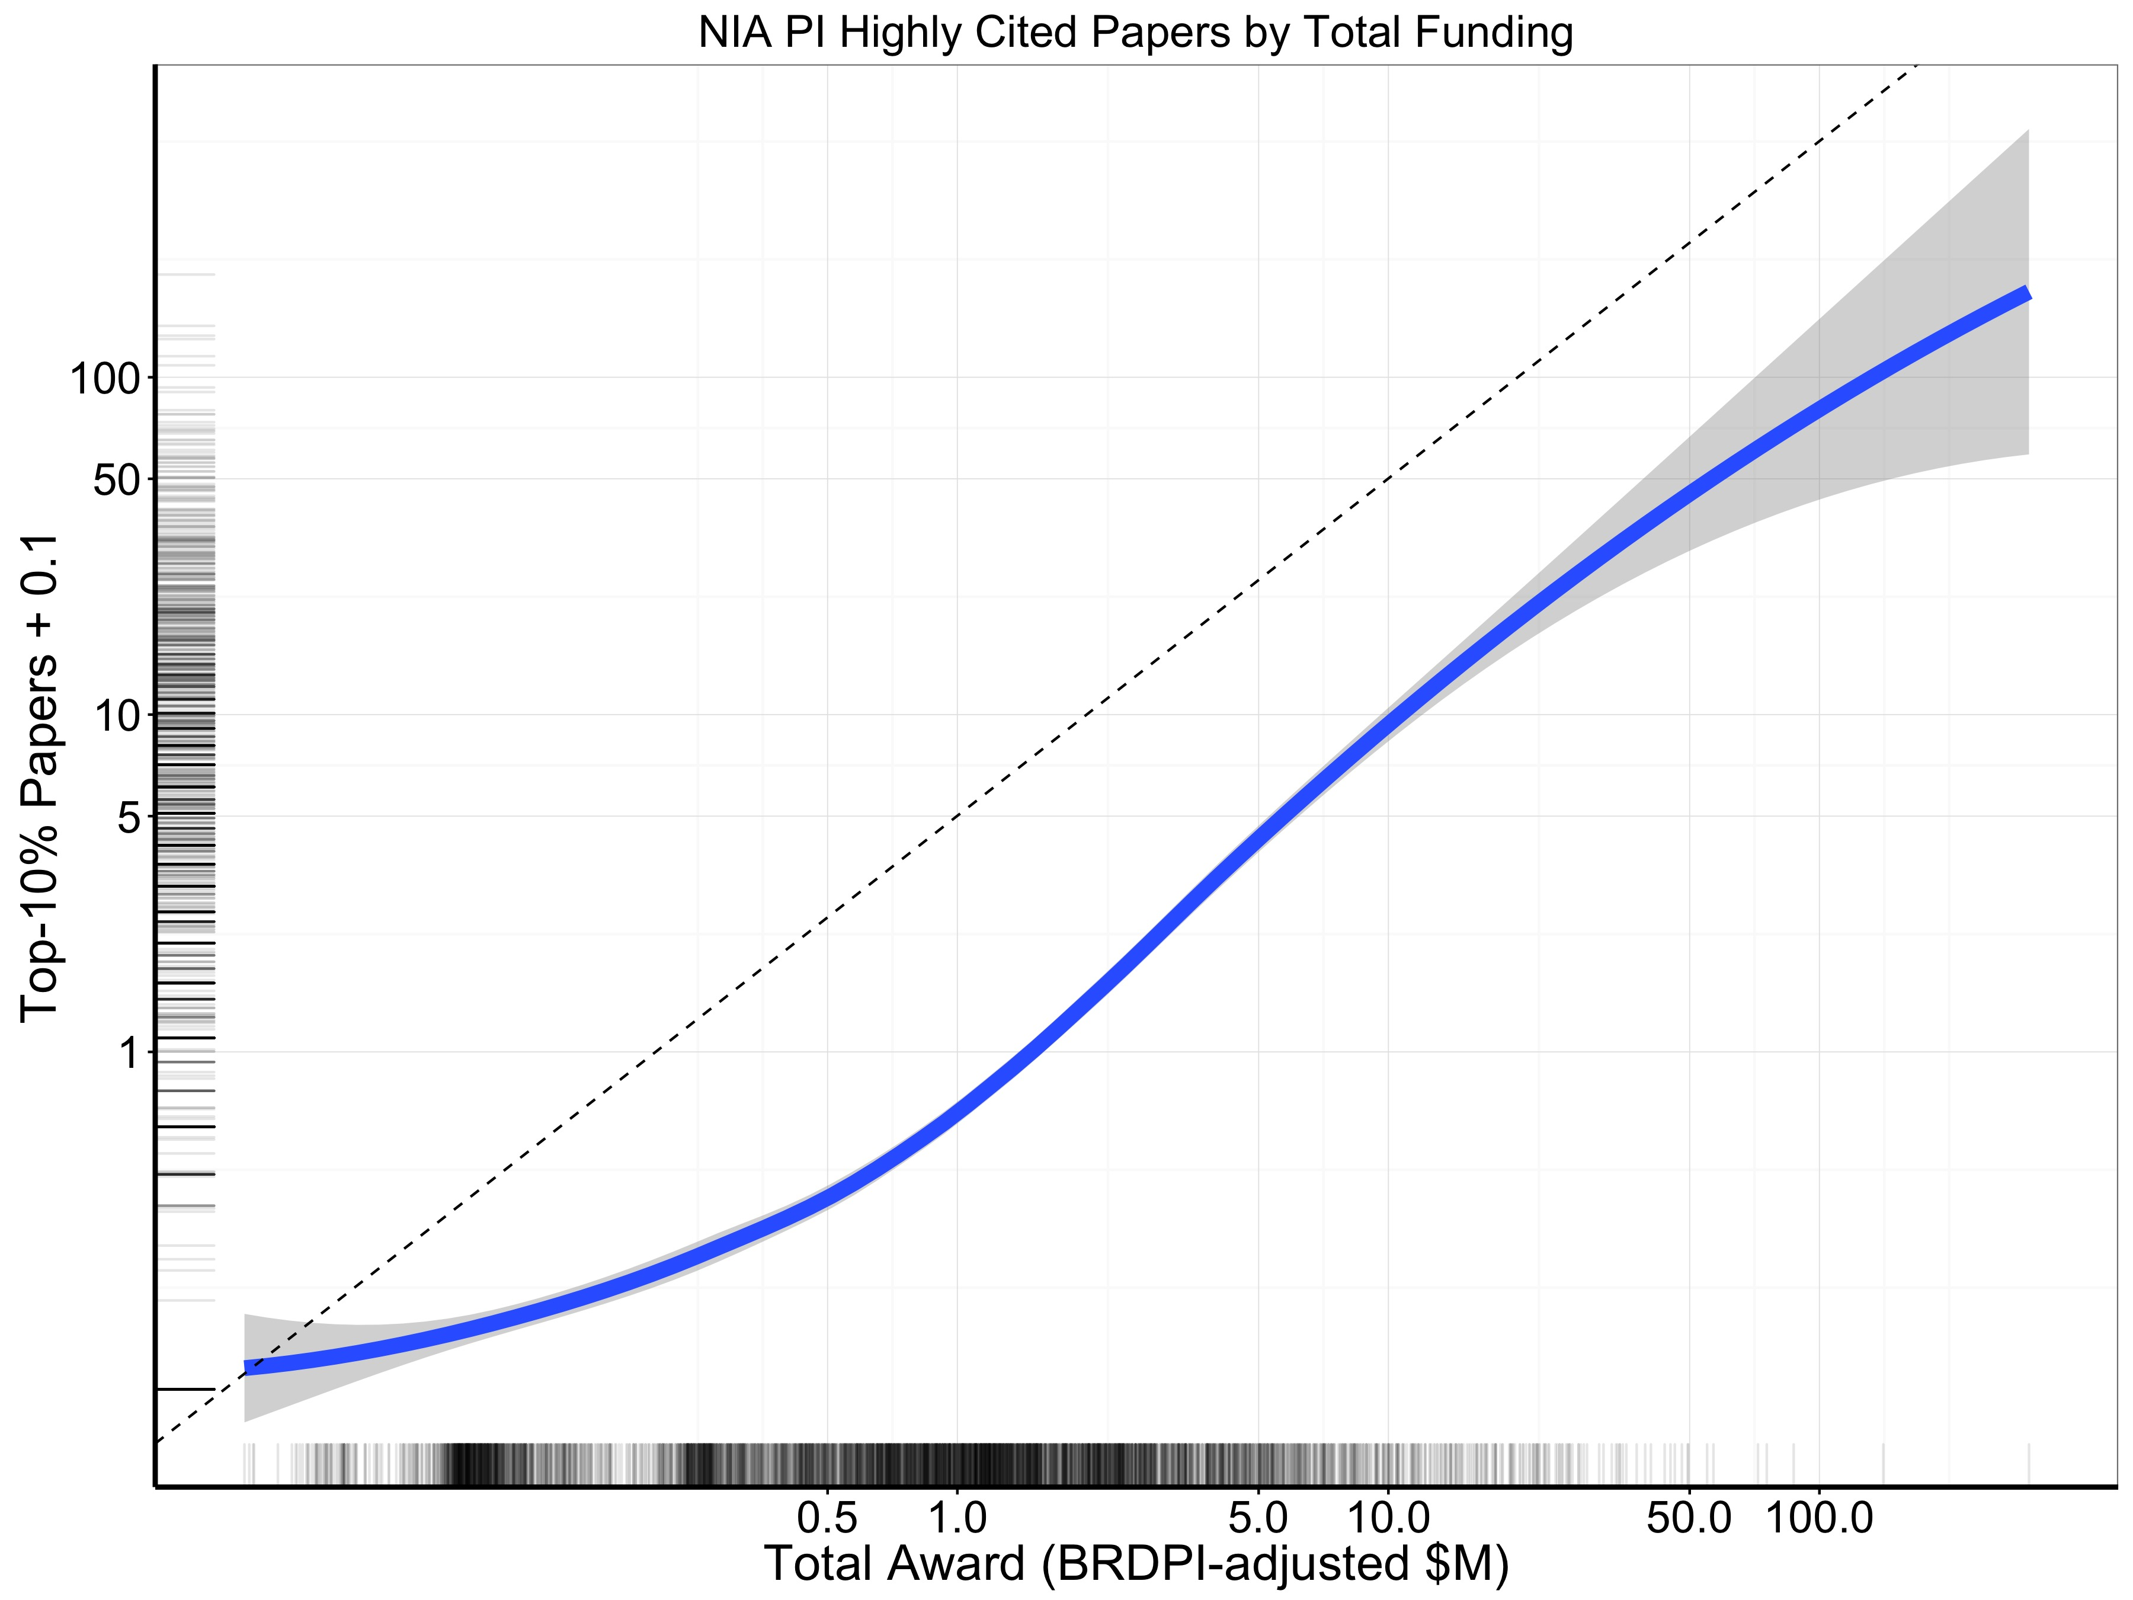
Notes:
1985-2011 (now)

Slide 15
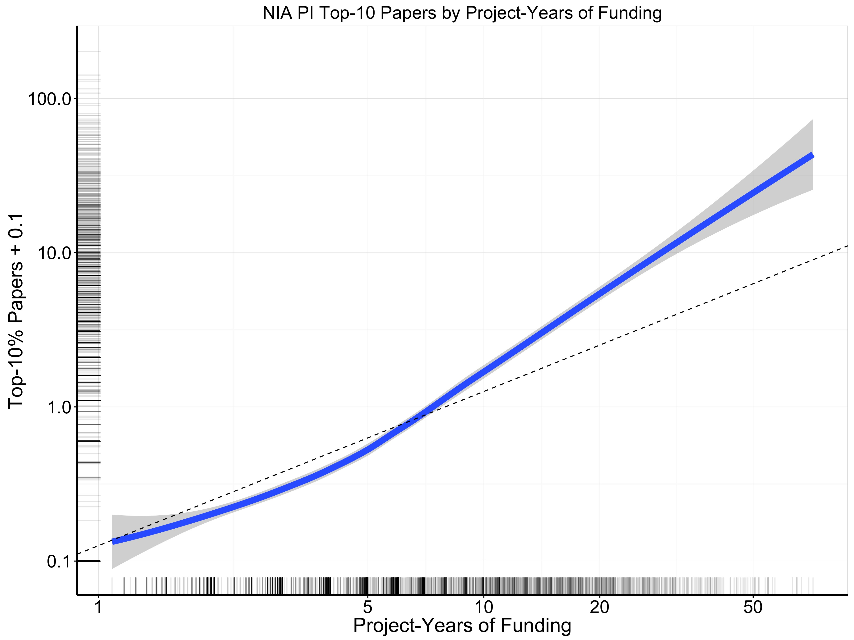

Slide 16
25-30% of grantees have ≥ 2 NIH grants
5% of grantees have 25% of the funds
20% of grantees have 50% of the funds

Slide 17
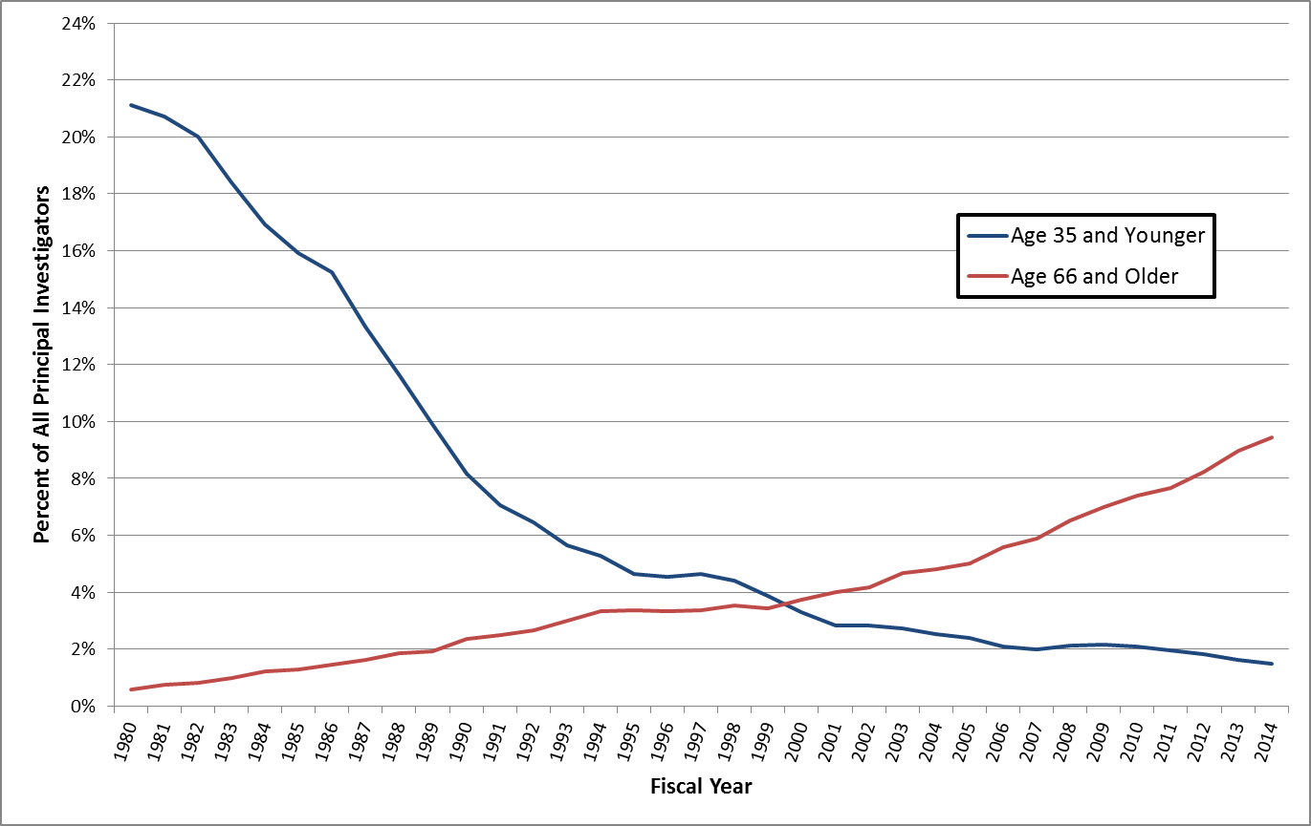
Percentage of NIH R01 Equivalent Principal Investigators of All Degrees:
Age 35 and Younger vs. Age 66 and Older, Fiscal Year 1980 - 2014
Source data for chart is in this embedded worksheet
Notes:
Include all common doctoral level degrees or equivalents (e.g., MD/PhD/DVM/DDS) and any other professional degrees (e.g.. MDOT, BOTH, etc.).
R01 includes R01 equivalents (i.e. R01, R23, R29 and R37).

Slide 18
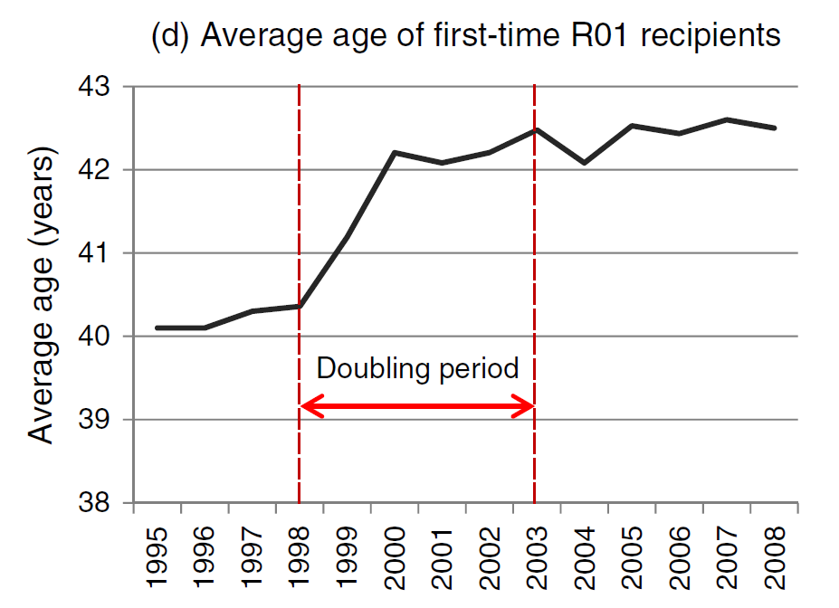
Doubling and Recipient Age
Larson RC et al. Serv Sci 2012;4:382-95

Slide 19
Change in number of submissions,
2010-2014 by years since PhD
Robin Barr NIA

Slide 20
NIA ESI R01 awards 2009 through 2014
2009 | 2010 | 2011 | 2012 | 2013 | 2014
25 | 30 | 35 | 31 | 24 | 29
In 2009 through 2013 the ESI advantage in the pay line
was five percentage points.
In 2014 the ESI advantage was ten percentage points

Slide 21
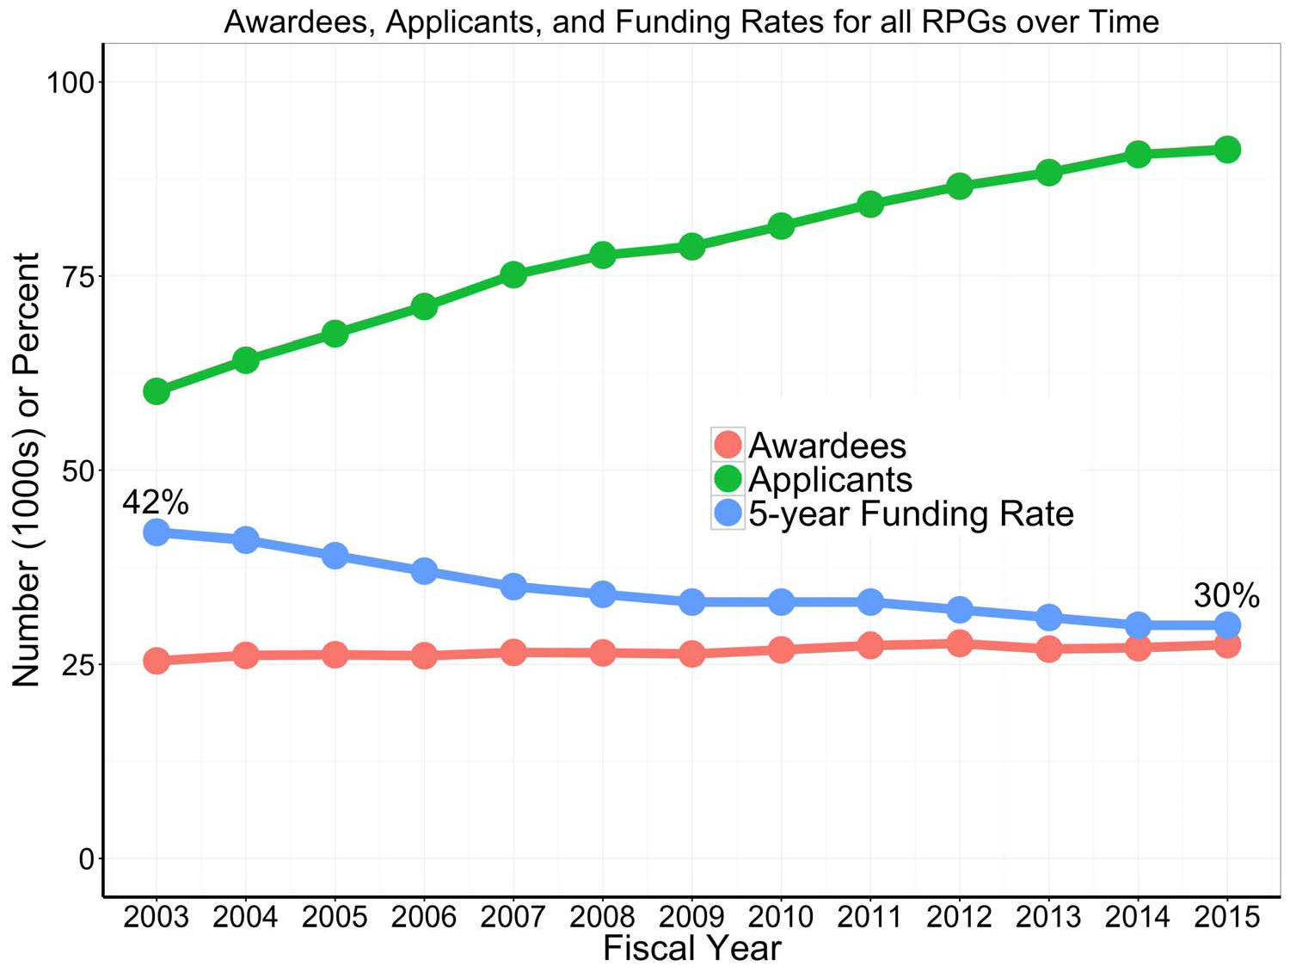

Thanks to OER DPEA and SARB

Slide 22
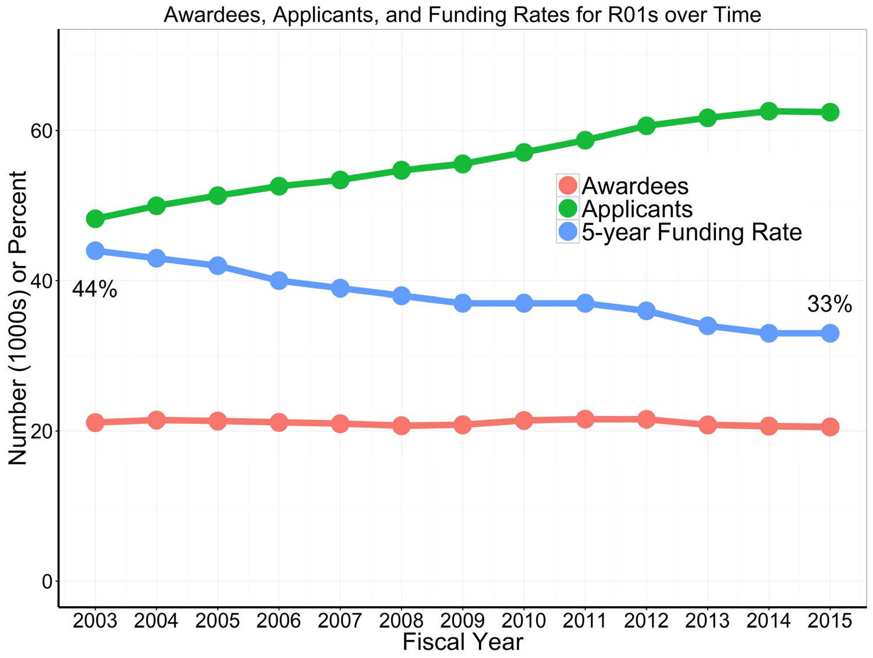
Thanks to OER DPEA and SARB

Slide 23
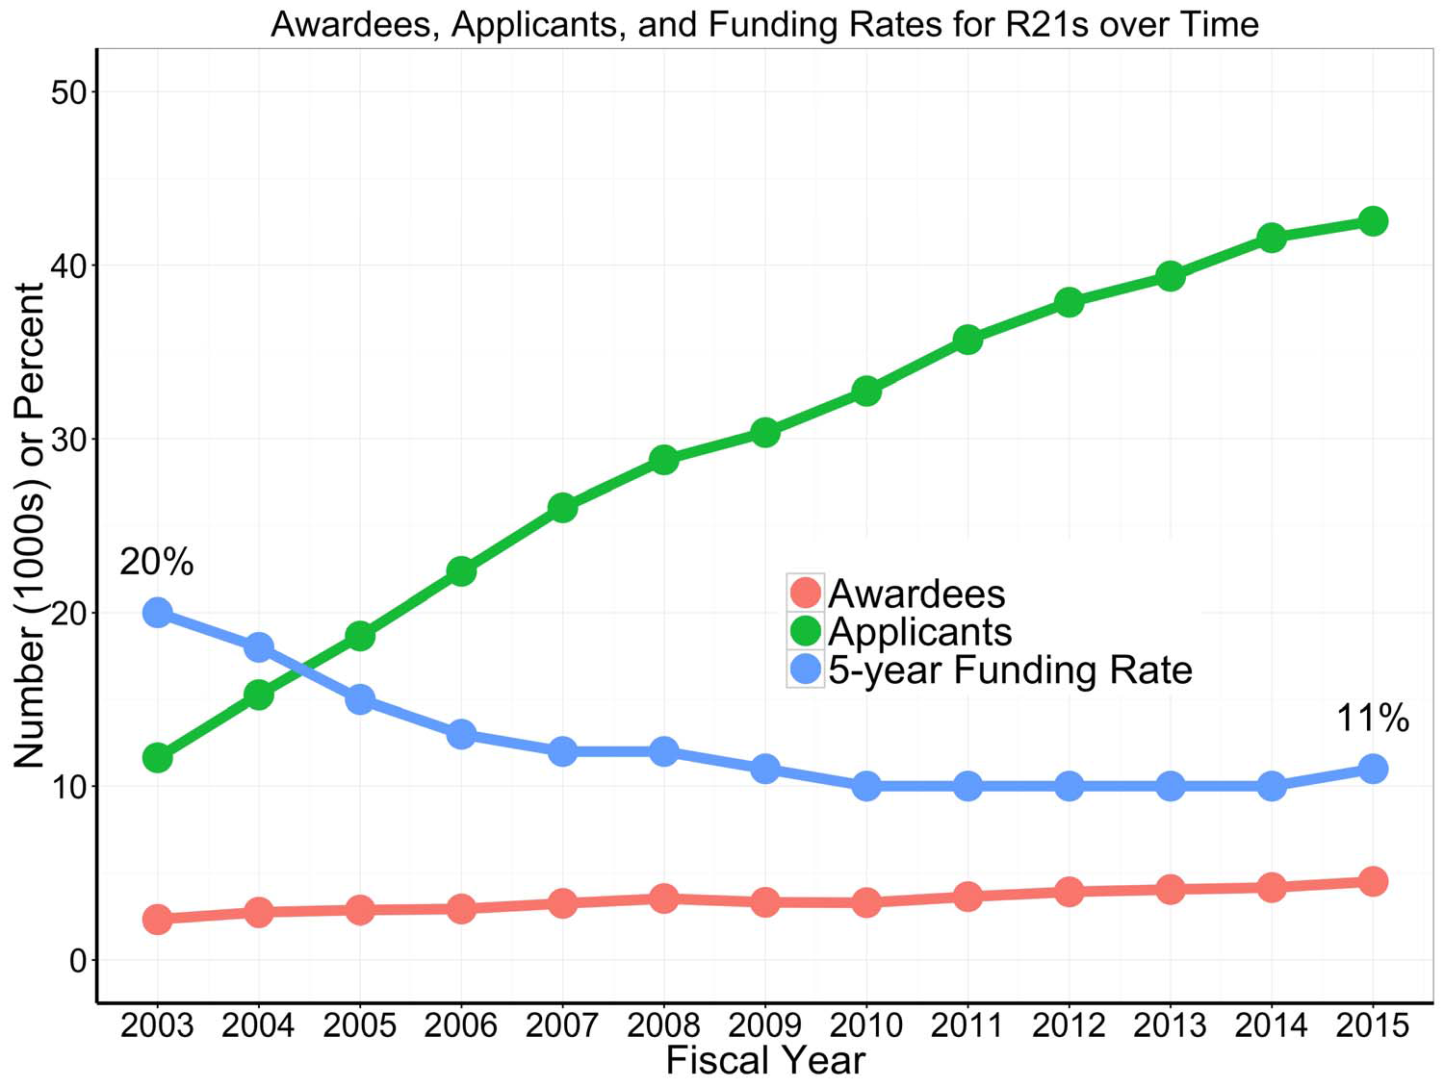

15

Slide 24
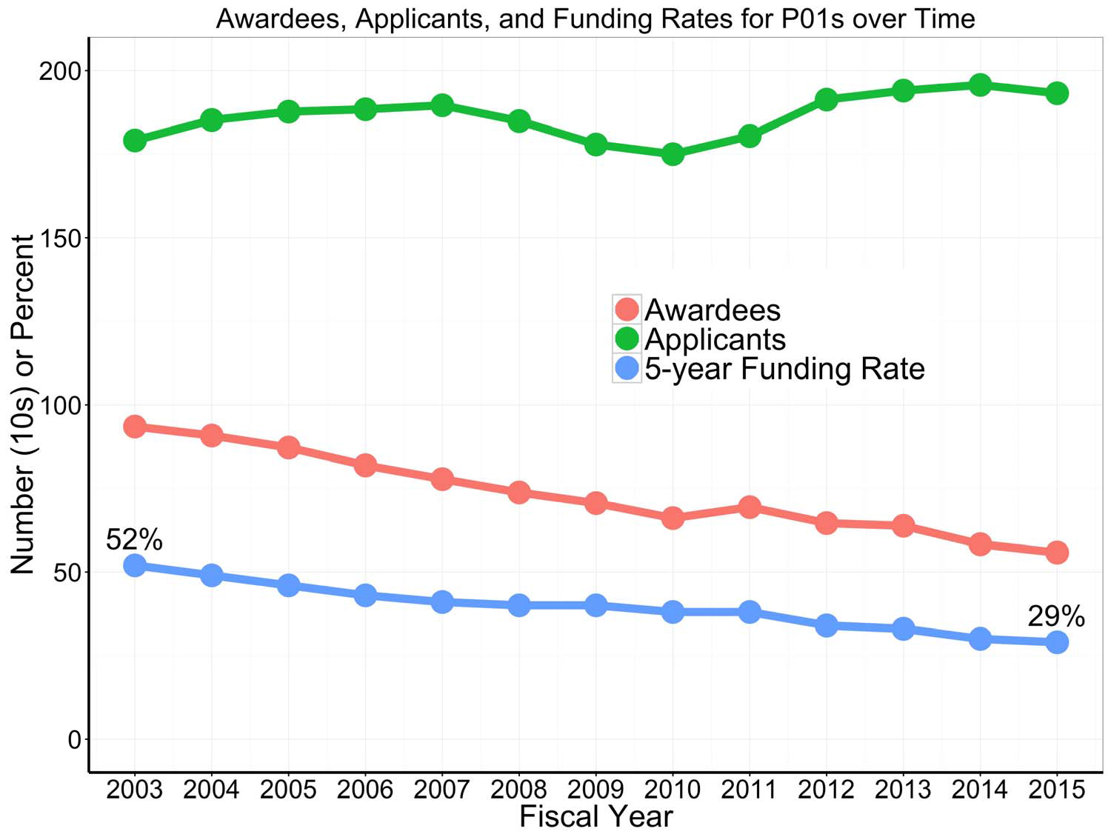
Thanks to OER DPEA and SARB

Slide 26
Three Perspectives
Paper-based
Grant-based
Scientist-based

Slide 27
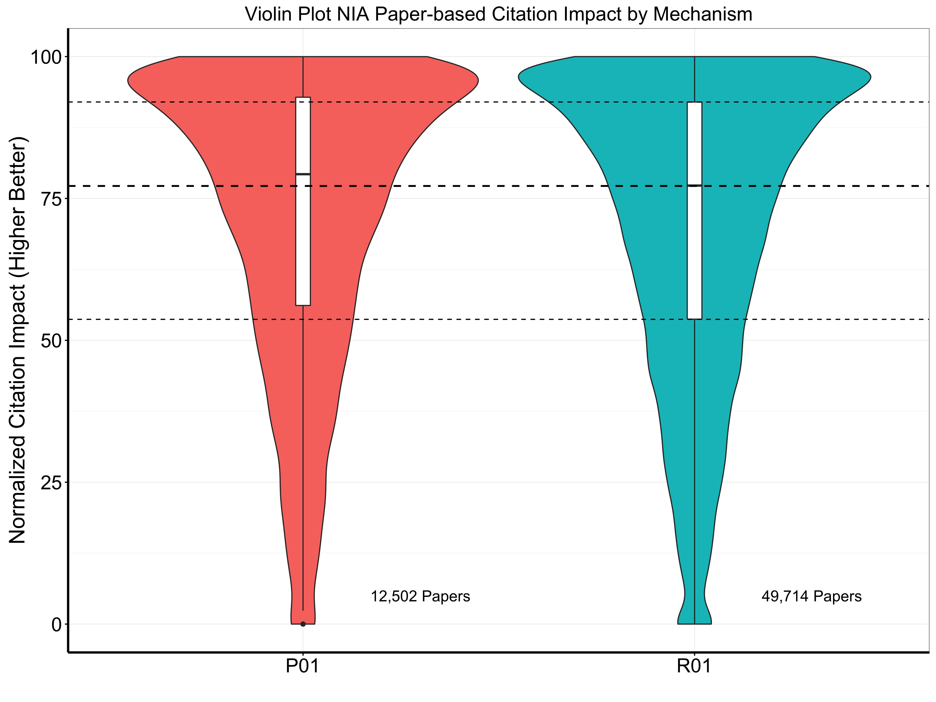

Slide 28
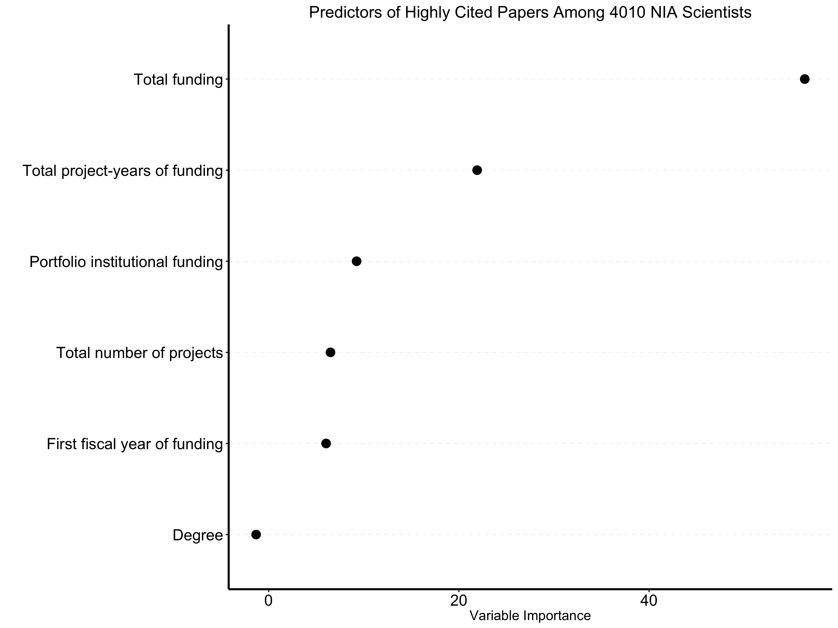
Notes:
Interpretation: total funding (~50-60) >> project-years of funding (~25) ➔ funding/year is important, though first FY funding less important (<10)

Slide 29
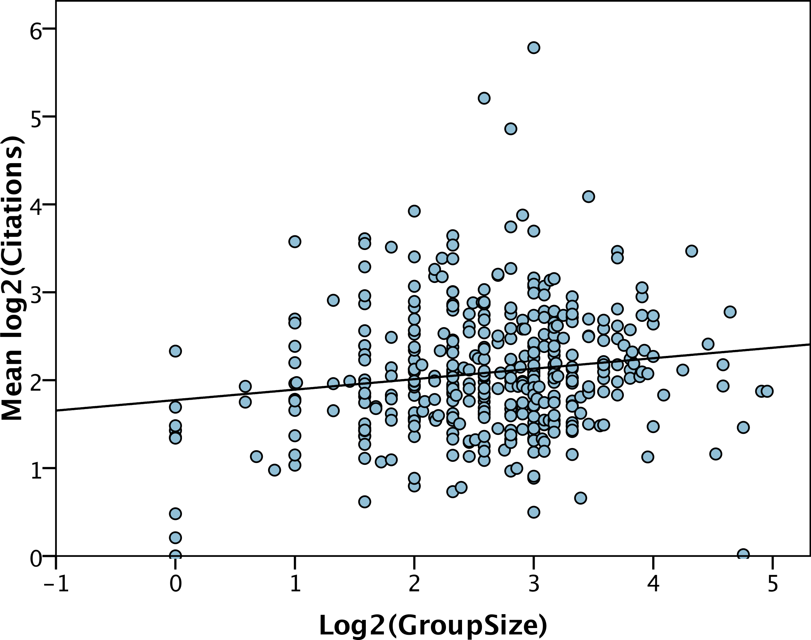
Diminishing Scientific Returns with Lab Size
Diminishing returns with increased funding also seen in:
NIMH (Doyle et al., 2015 )
Other U.S. funders (Gallo et al., 2014)
Canada (Fortin and Currie, 2013)
Cook, I et al. (2015) Peer J. 3:e989 https://dx.doi.org/10.7717/peerj.989
Notes:
This results versus previous slides #14, 16, 17

Slide 30
Productivity Does Not Scale Proportionally with Funding
300
250
200
Number of Publications (2010-2015)
150
100
50
0
200
300
400
500
600
700
800
900
1,000
1,500
2,000
>2,000
3-Year-Averaged Total Annual NIH Direct Costs ($1,000s)
Notes:
This results versus previous slides #14, 16, 17

Slide 31
Bibliometric Outcomes
Data from Thomson Reuters (95% match)
Each paper binned by:
  Topic (empiric, one of 252)
  Year of publication
  Article type (research, review)
Each paper percentiled in its bin
Hicks D, Wouters P et al. Nature 2015;520:429-31
Bornmann L, Marx W. EMBO Reports 2013;14:226-30

Slide 32
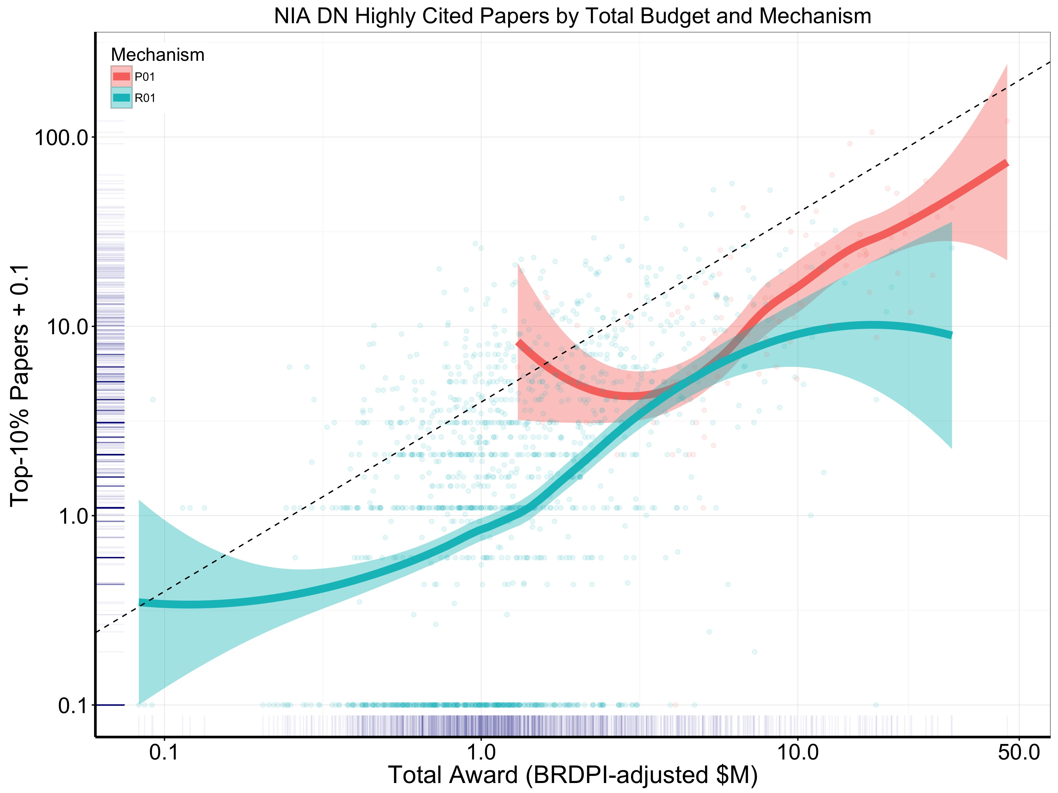

Slide 33
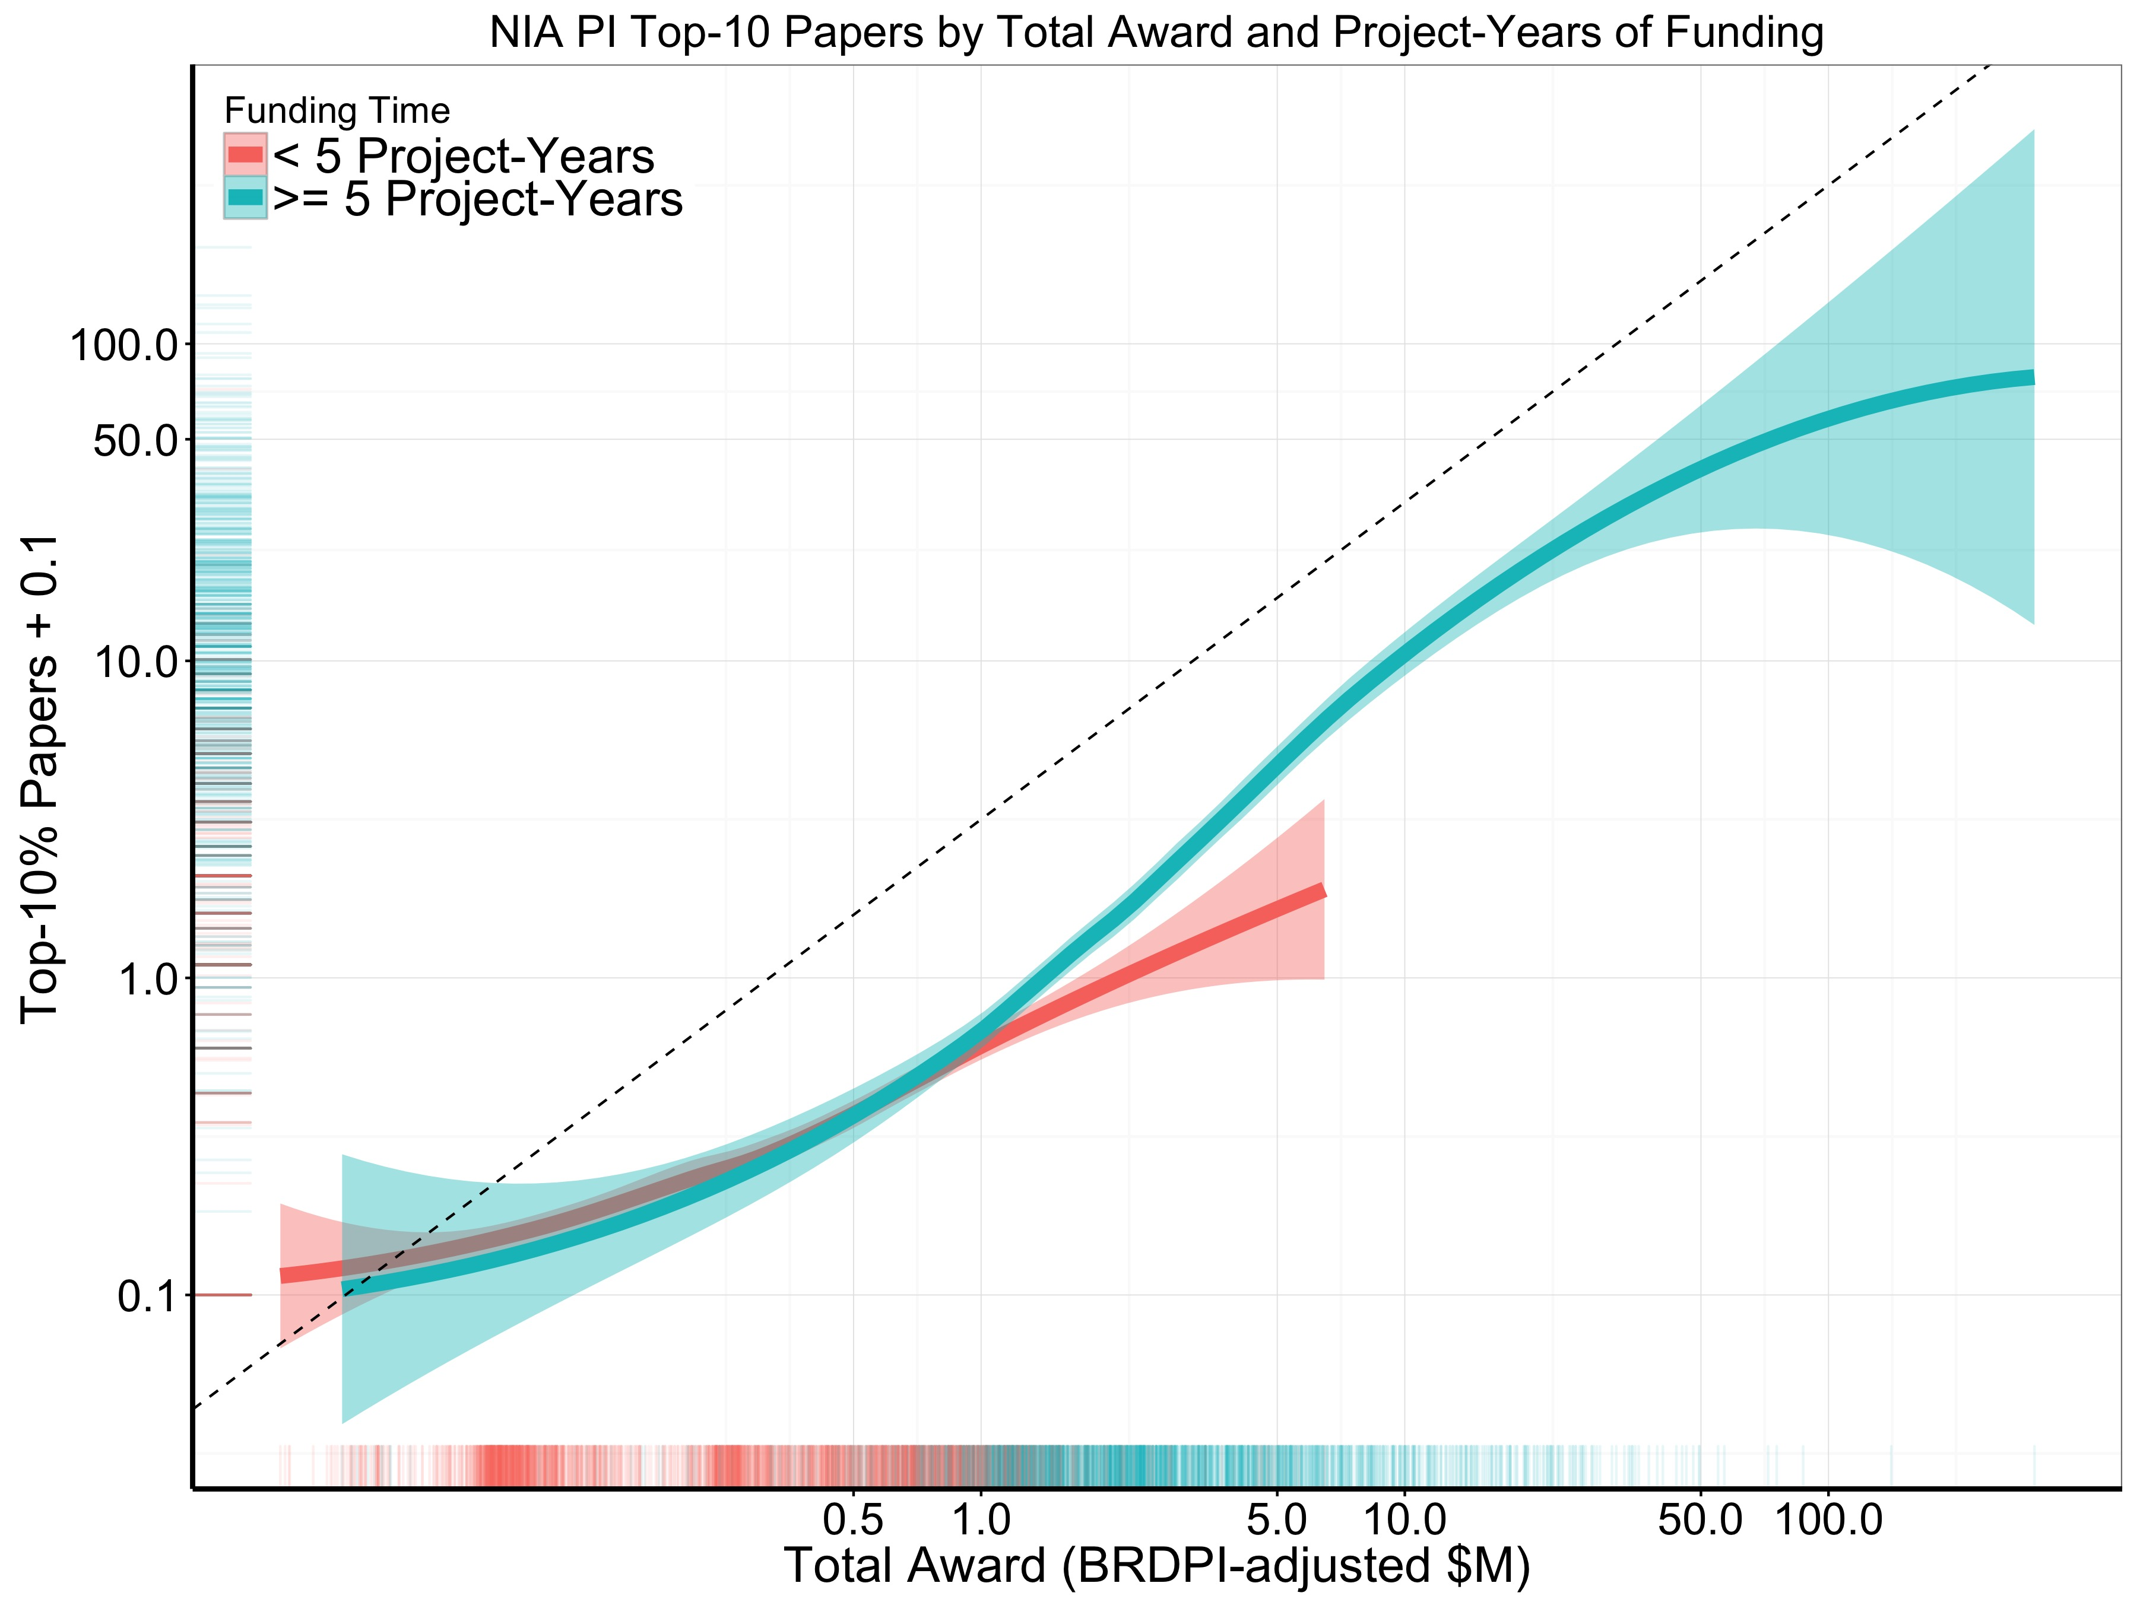

Slide 34
Bibliometric Outcomes
 | P01 (N=193) | R01 (N=3667)
Publications | 34 (16-66) | 6 (3-13)
Highly-cited Publications | 10 (4-20) | 1 (0-3)
Proportion Highly-Cited | 27% (17%-39%) | 16%(0-36%)
Highly-Cited per $Million | 1.2 (0.6-2.0) | 0.9 (0-2.6)
Continuous variables: Value (25th – 75th percentiles)
Categorical variables: Column percent
All P < 0.0001

Slide 35
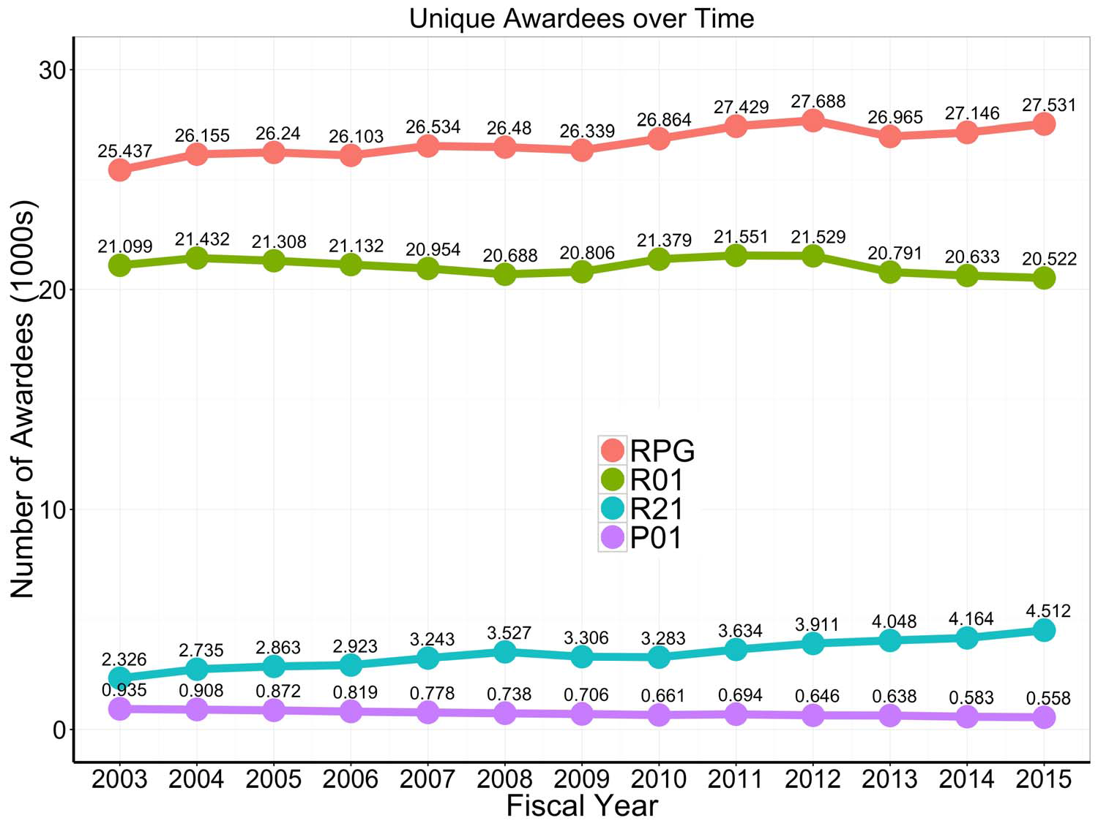
7

