Slide 1
The Human Immune System
Lori Herrington
Chaparral High School

Slide 2
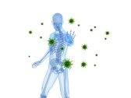
What is immunology?
Very simply, it is the study of our body’s defense against infection and disease.
Even though we are constantly bombarded by microorganisms, we rarely become sick. Why?

Slide 3
Why?
The reason why we rarely become ill is because our bodies have a built-in defense system. It’s called our immune system.

Slide 4
So what is an immune response?
When an invader or pathogen enters our body, the response we make against infection is called an immune response.
Pathogens are microorganisms like bacteria, viruses, fungi, or parasites. Each has the potential for making us ill.

Slide 5
Components of the immune system
Bone marrow
Thymus
Spleen
Lymph nodes
Adenoids
Tonsils
Peyer’s patches
Appendix
Lymphatic vessels

Slide 6
Defense Against Infections & Disease
Our bodies are always ready to defend against invasion—the first line of defense is our skin and other bodily secretions (mucus, tears, sweat and saliva)
Mucus acts as a trap where microorganisms are swallowed and then digested
Tears, sweat and saliva all contain lysozyme, an enzyme that can break down the cell wall of some bacteria.

Slide 7
Innate Immunity
Innate immunity prevents pathogens from entering the body, but, if they do, our bodies eliminate the pathogen before the occurrence of disease or infection.
Characteristics of Innate Immunity
Present from birth
Non-specific
Does not become more effective with more exposure to pathogen

Slide 8
Innate Immunity continued…
The first cells to respond after invasion are phagocytic cells, like macrophages or neutrophils
These cells produce toxic chemicals or are able to ingest & kill microbes.
Phagocytes and other proteins (like opsonin) are located mostly in blood
Inflammation is the means by which these elements are recruited to the tissue invasion site

Slide 9
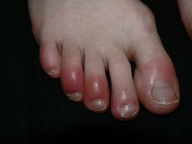
Inflammation
Inflammation is characterized by four symptoms:
Redness
Swelling
Pain
Heat
This occurs when damaged tissue and white blood cells (basophils), release histamine. Histamines, released from mast cells, cause the blood vessels to dilate allowing the tissue to become more permeable to tissue fluid.

Slide 10
More on inflammation…
Inflammation is localized to the area of infection/tissue injury by the release of substances from micro-organisms or chemicals (chemical mediators) released from cells in tissues.
e.g. histamine from MAST CELLS: Once the micro-organisms are destroyed, inflammation subsides.

Slide 11
Adaptive Immunity
If an infection continues, then another part of the immune system is mobilized. This is our adaptive or acquired immunity.
An adaptive response occurs when our body recognizes an antigen (something other than our self) and produces antibodies against it.

Slide 12
More on Adaptive Immunity…
Adaptive immunity is an antigen-specific defense mechanism and can take several days to become protective.
Adaptive immunity becomes more effective with more exposures to an antigen.
There are two major branches of the adaptive immune system:
Humoral immunity
Cell-mediated immunity

Slide 13
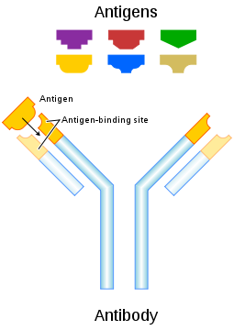
Humoral Immunity
Involves the production of antibodies
An antibody is a protein produced by the body when it detects antigens.
Each antibody is particular and defends again a specific type of antigen.
This response is mediated by B-cells.
Humoral Immunity Video clip

Slide 14
Cell-Mediated Immune Response
Cell mediated immunity involves cytotoxic or killer T-cells.
Cell-mediated Immunity video clip

Slide 15
References
http://www.123rf.com/photo_7308748_male-skeleton-blocking-viruses.html
http://palscience.com/health-medicine/scientists-discover-immunity-reserve-system-for-the-body/
faculty.evansville.edu/md7/bact02/...files/SpecificDefenses.ppt
http://en.wikipedia.org/wiki/Inflammation
www.microbiologybytes.com/iandi/1b.html
http://en.wikipedia.org/wiki/Antibody
http://www2.bc.cc.ca.us/bio16/16_adaptive_immune.htm
http://appscgroup.blogspot.com/2010/12/types-of-immunity-appsc-g1-mains-p4-s2.html

