Slide 1
Peer Review and Grant Mechanisms at NIH What is Changing? May 2016
Richard Nakamura, Ph.D., Director Center for Scientific Review

Slide 2
NIH and CSR thanks AAI membership for scientific accomplishment and support of peer review!

Slide 3
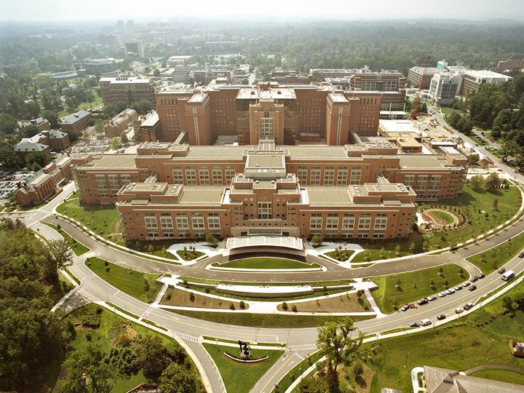
National Institutes of Health
We seek fundamental knowledge about the nature and behavior of living
systems and the application of that knowledge to enhance health, lengthen
life, and reduce illness and disability.

Slide 4
CSR: The Gateway for NIH Grant Applications
The Center for Scientific Review
Receives all NIH applications
Refers them to NIH Institutes/Centers and to scientific review groups
Reviews for scientific merit about 75% of all NIH applications

Slide 5
CSR Mission
To see that NIH grant applications receive fair, independent, expert, and timely reviews – free from inappropriate influences – so NIH can fund the most promising research.

Slide 6
2-Level Review System for NIH Grants
First Level of Review
Scientific Review Group
(Study Section) at CSR or IC
Second Level of Review
NIH Institute/Center Council
About 80,000 applications and 17,000 reviewers

Slide 7
The Peer Review and Award Process

Slide 8
NIH Grants Workshop: Demystifying the grant application submission, review and funding processes Room 3 AB Sunday May 15 12:30pm – 2:30pm NIH Grant Review and Funding Info Room Room 400 Sunday May 15 and Monday May 16

Slide 9
Role of the Scientific Review Group (SRG) or Study Section
A federal advisory group, consisting of independent scientists, that evaluates grant applications for NIH.
Provides scientific impact scores and critiques of each grant application under the official supervision of a scientifically trained federal official
The scores are rank ordered and percentiled and sent along with the application and summary statement to an institute for award consideration

Slide 10
The Study Section Meeting
The SRO Convenes the Study Section Meeting
Notes:
WHAT IS A STUDY SECTION MEETING LIKE?
Each CSR standing Study Section has typically ~12-25 regular members who are primarily from academia, but also from biotech industry and sometimes government research laboratories. Temporary members may be recruited to fulfill specific review needs.
Typically about 60-100 applications are reviewed by each study section

Slide 11
Role of the Scientific Review Officer
Scientifically trained Federal Official with overall responsibility for the review process
Performs administrative and technical review of applications to ensure completeness and accuracy
Nominates reviewers and chair based on broad input
Provides CSR training for reviewers and chair
Prepares summary statements

Slide 12
Role of Study Section Chair
Senior extramural scientist that partners with their Scientific Review Officer to conduct the meeting
Guides and summarizes study section discussion
Ensures all study section member opinions are given careful consideration
Manages scientific discussions at the meeting, e.g., timeliness and thoroughness
Acts as the scientific face of an area of science and its support

Slide 13
Reviewers
Ph.D. or M.D. in relevant research area
Successful at competitive, independent research
Excellent publications, scientific and professional recognition
Demonstrated wisdom, selflessness, cooperativity in review
Demonstrated scientific independence
Diversity of perspectives, gender, race/ethnicity, region

Slide 14
Discussions Focus on the Best Applications
Reviewers discuss application in rank order based on preliminary impact scores
Reviewers typically discuss the top half the applications
The panel will discuss any application a reviewer wants to discuss
Notes:
The applications are ranked (ordered) by their Average Preliminary Overall Impact scores and arranged from best to worst.
Reviewers typically discuss the top half the applications
Any reviewer can bring to the discussion any application from the potentially ND list.

Slide 15
Summary Statement
Scores for each review criterion
Critiques from assigned reviewers
Administrative notes if any
If an application is discussed, applicants receive:
An overall impact/priority score and percentile
ranking, which helps determine funding
A summary of review discussion
A budget recommendation
Notes:
After the meeting each application will receive a Summary Statement. Summary Statements are the official agency record of the evaluation and recommendations made by the peer review group.

Slide 16
Short Cut: Early Career Reviewer Program
Train and educate qualified scientists to become critical and well-trained reviewers
Expose investigators to the peer review experience to help make them more competitive as applicants
Enrich the existing pool of NIH reviewers
www.csr.nih.gov/ecr

Slide 17
What Happens After Scientific Reviews
Review results sent to the applicants and the NIH Institutes
NIH Institutes and Centers:
Conduct second level review for relevance to priorities and public health needs.
Seek input from their advisory councils, which include community representatives and patient advocates.
Make final funding decisions.
Help all applicants take the next steps forward.

Slide 18
Role of the NIH Program Officer
Work with the scientific community to assess research needs and opportunities. Develop funding opportunity announcements.
Attend peer review meetings and help applicants understand their reviews and advise on next steps.
Make award priority recommendations to Council and IC, including modifications to aims, award amount and duration.
Oversee grants in their scientific areas and monitor performance.
Work with grants management staff to ensure research is progressing and government regulations are followed.

Slide 19
“Change favors the prepared mind” -misquoted from Louis Pasteur

Slide 20
What is changing?
Rigor and Transparency
R35 Investigator based awards
Preprints

Slide 21
First, NIH has not changed its support for basic science. Use “Public health relevance” based on the NIH mission. Do not make unsupportable claims

Slide 22
Rigor and Transparency

Slide 23
Rigor and Transparency in Research
To support the highest quality science, public accountability, and social responsibility in the conduct of science, NIH’s Rigor and Transparency efforts are intended to clarify expectations and highlight attention to four areas that may need more explicit attention by applicants and reviewers:
Scientific premise
Scientific rigor
Consideration of relevant biological variables, such as sex
Authentication of key biological and/or chemical resources
Role of reviewers: Assess the scientific merit of each application according to the review criteria, which include consideration of scientific premise, rigor, and consideration of relevant biological variables, and the adequacy of the authentication of key biological and/or chemical resources as an administrative issue. Evaluations should be based on current best practices in the field.

Slide 24
Reviewing Rigor and Transparency of Research: RPG Applications
 | Applies to which applications? | Where will I find it in the application? | Where do I include it in my critique? | Addition to review criteria | Affect overall impact score?
Scientific Premise | All | Research Strategy (Significance) | Significance | Is there a strong scientific premise for the project? | Yes
Scientific Rigor | All | Research Strategy (Approach) | Approach | Are there strategies to ensure a robust and unbiased approach? | Yes
Consideration of Relevant Biological Variables, Such as Sex | Projects with vertebrate animals and/or human subjects | Research Strategy (Approach) | Approach | Are adequate plans to address relevant biological variables, such as sex, included for studies in vertebrate animals or human subjects? | Yes
Authentication of Key Biological and/or Chemical Resources | Project involving key biological and/or chemical resources | New Attachment | Additional review considerations | Comment on plans for identifying and ensuring validity of resources. | No
Notes:
Rigor and transparency do not apply to all applications. See List of Eligible Activity Codes: https://nih-extramural-intranet.od.nih.gov/d/sites/default/files/RigorActivityCodes-20151006.pdf. Also, certain Funding Opportunity Announcements are exempt from rigor, by request from the ICs.

Slide 25
Reviewing Rigor and Transparency of Research: Mentored Career Development Applications
 | Applies to which applications? | Where will I find it in the application? | Where do I include it in my critique? | What should I consider? | Affect overall impact score?
Scientific Premise | All | Research Strategy | Research Plan | Is there a strong scientific premise for the project? | Yes
Scientific Rigor | All | Research Strategy | Research Plan | Are there strategies to ensure a robust and unbiased approach? | Yes
Consideration of Relevant Biological Variables, Such as Sex | Projects with vertebrate animals and/or human subjects | Research Strategy | Research Plan | Are adequate plans to address relevant biological variables, such as sex, included for studies in vertebrate animals or human subjects? | Yes
Authentication of Key Biological and/or Chemical Resources | Projects involving key biological and/or chemical resources | New Attachment | Additional review considerations | Comment on plans for identifying and ensuring validity of resources. | No
Notes:
Rigor and transparency do not apply to all applications. See List of Eligible Activity Codes: https://nih-extramural-intranet.od.nih.gov/d/sites/default/files/RigorActivityCodes-20151006.pdf. Also, certain Funding Opportunity Announcements are exempt from rigor, by request from the ICs.

Slide 26
What is changing?
Rigor and Transparency
R35 Investigator based awards
Preprints

Slide 27
Improving Peer Review

Slide 28
Improving peer review with science
Understanding noise in peer review - reliability
Judging scoring systems – avoiding score compression, capturing group ranking
Evaluating review criteria and the role of investigator and environment
Picking good reviewers
Distributing applications appropriately across study sections
Emphasis on evaluations by scientists rather than metrics

Slide 29
Why scientists-in-training can continue to be optimistic about the future.

Slide 30
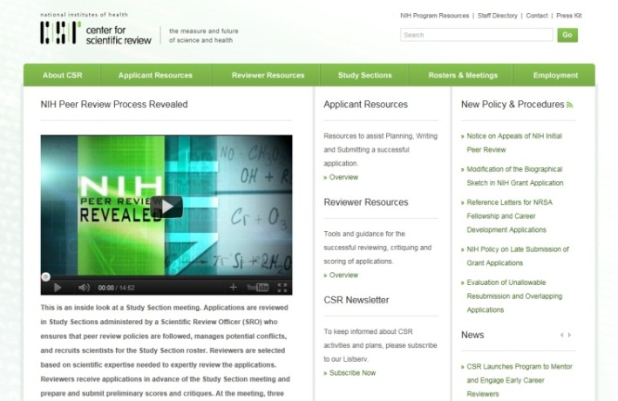
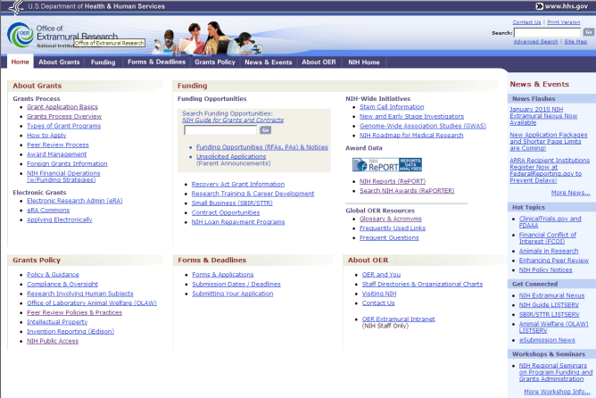
Key NIH Review and Grants Web Sites
NIH Center for Scientific Review
http://www.csr.nih.gov
NIH Office of Extramural Research
http://grants.nih.gov/
Notes:
A lot of critical information and answers to your questions can be found online . . . .

Slide 31
CSRDirector@csr.nih.gov

